Slide 1
PATIENT CASE SIMILARITY
PIP104 University Project-II
Review-1
Batch Number : G35
Roll Number | Student Name
20201CAI0200 20201CAI0182 20201CAI0183 20201CAI0202 | ANSHITA M LAVANYA K CHAITHANYA D SAHITHYA
Under the Supervision of
Dr. Swati Sharma
Associate Professor
School of Computer Science & Engineering
Presidency University

Slide 2
Introduction
Healthcare is constantly evolving and the focus on precise diagnosis and treatment has become more important than ever. However, one of the biggest challenges is finding the similarities between patient cases that can be quite complex. That's where our research comes in. We're exploring how Deep Neural Networks (DNNs) can help us better understand patient cases and uncover the subtle relationships that exist between them. Our research is called "Unveiling the Synergistic Precision" and it's all about using advanced computational methods and healthcare analytics to make breakthroughs in personalized medicine. We're taking a "deep dive" into neural networks to see how they can help us decipher complicated medical data and uncover new insights into how patients can be treated. The idea behind "synergistic precision" is that by combining DNNs with patient data, we can better understand each patient's unique case and tailor their treatment accordingly. This is a big step beyond traditional methods, which often miss the subtle nuances that can make a big difference in a patient's care. We believe that our research will help refine clinical decision support systems and ultimately lead to more personalized medical interventions. Our paper doesn't just focus on the technical aspects of using DNNs in healthcare. We also look at how this technology can impact healthcare practitioners and the entire field of personalized medicine. By unveiling the potential of DNNs, we're creating a future where artificial intelligence and healthcare come together to redefine the standard of care. We're excited to take this journey and invite everyone to join us as we explore the potential of cutting-edge deep neural networks in reshaping patient-centric healthcare

Slide 3
Literature Review
Interdisciplinary Perspectives : The literature emphasizes how interdisciplinary patient case analysis is, using knowledge from data analytics, computer science, and medicine to improve methods that make use of deep neural networks.
Problems with Patient Case Similarity : Our investigation of sophisticated deep learning methods to get over current constraints is based on prior research that tackles problems with patient case similarity. The paradigm shift towards precision medicine is supported by literature, which highlights the necessity for advanced instruments like deep neural networks to fully understand the complexity of patient cases. Ethical Considerations: In order to examine the ethical implications of using state-of-the-art deep neural networks for in-depth patient case analysis, the literature analyzes issues pertaining to patient privacy and data security.

Slide 4
Research Gaps Identified
There a number of drawbacks to using nearest neighbor and clustering methods for patient case similarity. Some of the most common drawbacks include:
Sensitivity to outliers: These methods are sensitive to outliers, which can significantly impact the accuracy of the results.
Curse of dimensionality: The nearest neighbor algorithm and clustering method is not well-suited for high-dimensional data, which is common in patient case similarity. As a result, the algorithm may identify as similar points that are actually quite different from each other.
Parameter tuning: These methods require careful parameter tuning, which can be difficult. There are a number of parameters that need to be set for patient case similarity
Lack of interpretability: These methods are not very interpretable, which can make it difficult to understand the results. Interpretability is the ability to understand the decision-making process of an AI model.
High computational cost/ Scalability: These methods can be computationally expensive, especially for large datasets. This can make them impractical to use for applications.

Slide 5
Proposed Method
1. Data Preprocessing
- Standardization: Standardize numerical features to have a mean of 0 and a standard deviation of 1.
- One-hot encoding: Encode categorical features into binary vectors.
- Temporal discretization: Discretize temporal data into meaningful intervals.
2. Deep Neural Network Architecture:
- Input layer: The input layer receives the pre-processed patient data.
- Hidden layers: Multiple hidden layers extract high-level features from the input data.
- Output layer: The output layer produces a similarity score for each pair of patients.

Slide 6
Proposed Method
3. Training the Deep Neural Network:
- Choose a loss function: A loss function measures the difference between the predicted similarity scores and the ground truth similarity scores.
- Optimization algorithm: An optimization algorithm updates the model parameters to minimize the loss function.
- Evaluation metrics: Evaluate the model's performance using metrics such as precision, recall, and F1 score.
4. Patient Similarity Calculation:
- Patient representation: Represent each patient as a vector of features extracted from the deep neural network.
- Similarity measure: Calculate the similarity between patients using a distance metric, such as Euclidean distance or cosine similarity.

Slide 7
Proposed Method
5. Applications:
- Personalized medicine: Identify patients similar to an index patient to inform treatment decisions.
- Clinical research: Stratify patient populations for clinical trials or discover biomarkers.
- Clinical decision support: Provide real-time case recommendations to clinicians.

Slide 8
Objectives
Develop a web application/ software framework to detect similarity between patient cases using AI, Machine Learning and deep Learning.
Integrate patient data to analyse similar cases
Analyse cases to diagnose the patient disease and identify the treatment

Slide 9
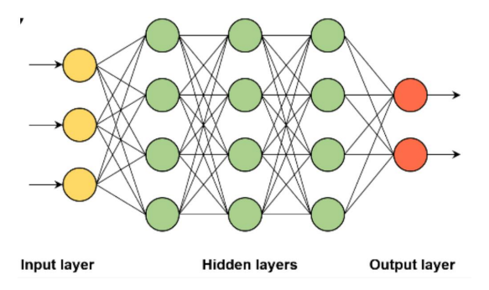
System Design
Figure 1.1 - Architecture of Deep Neural Network

Slide 10
Implementation
The input layer for the neural network consists of nodes equal to the number of features in the dataset. It's important to match the input shape with the dimensionality of our data. The hidden layers consists of three dense (fully connected) layers. Each layer has a specified number of neurons (64, 32, and 16, respectively) and uses the rectified linear unit (ReLU) activation function. The output of each layer serves asthe input for the next layer. Two separate output layers are defined, one for Diagnosis and one for Treatment Plan. Each output layer has 8 neurons and uses the softmax activation function.
ReLU, which stands for Rectified Linear Unit, is an activation function commonly used in artificial neural networks, including deep learning models.
f(x)=max(0,x)
In simpler terms, the output of the ReLU function is the input value if it is positive, andzero otherwise. Graphically, it looks like a ramp, allowing all positive values to pass through unchanged and setting all negative values to zero.

Slide 11
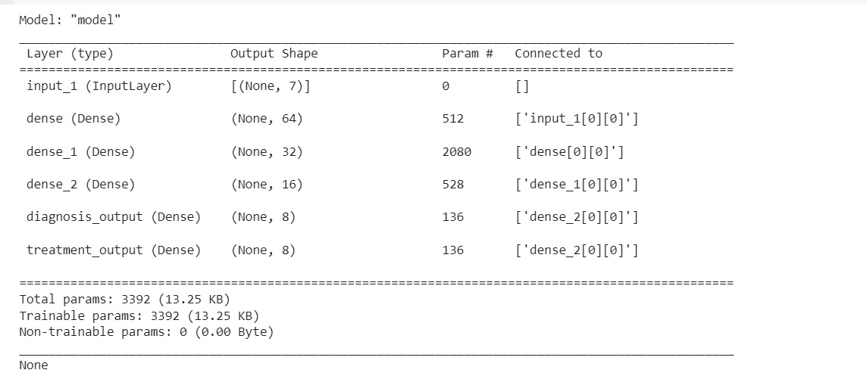
Model Dynamics

Slide 12
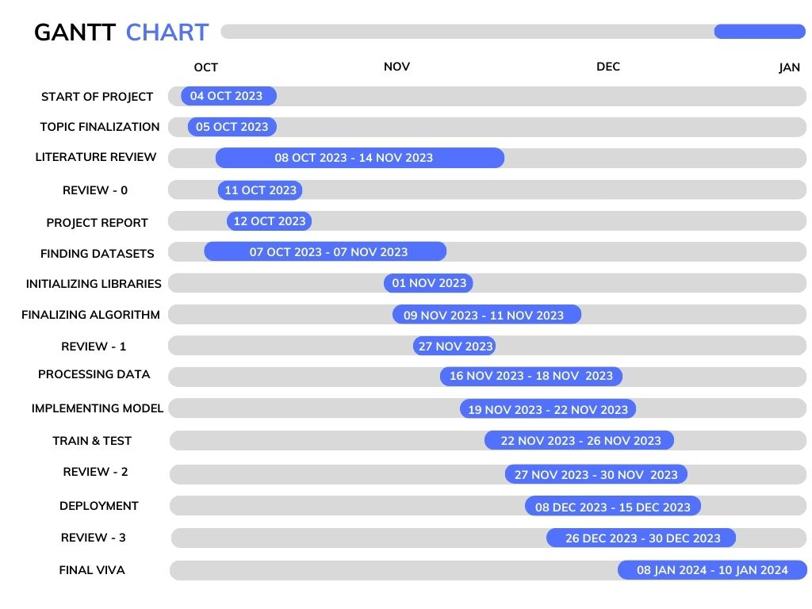
Timeline of Project by Gantt Chart

Slide 13
Outcomes
1. Personalized Medicine
2. Treatment Effectiveness
3. Research and Knowledge Discovery
4. Quality Improvement
5. Risk Stratification

Slide 14
Conclusion
The goal of this project is to use Deep Neural Networks (DNNs) to change patient case similarity analysis in the healthcare environment. The purpose is to negotiate the complex network of various patient situations, casting light on the shortcomings of traditional one-sizefits-all techniques, which frequently fall short of meeting the particular demands of individual healthcare scenarios. A rigorous approach was taken to improve the efficacy of our models, with a dual focus on enhancing both convergence and accuracy.
The use of separate activation functions, novel performance indicators, and carefully designed loss functions demonstrates a dedication to customizing DNNs to the complex nuances of patient case analysis. Recognizing the accuracy necessary in healthcare treatments, a special emphasis was made on grasping the multidimensional nature of healthcare of patient case analysis. Recognizing the need for accuracy in healthcare treatments, a special emphasis was made on recognizing the multidimensional nature of patient issues. Rectified Linear Unit (ReLU) and Softmax activation functions were specifically chosen for their ability to uncover subtle patterns within patient data.
The study pioneered the notion of "Synergistic Precision," which encapsulates our combined efforts converged on the one aim of patient change. This comprehensive approach takes into account not just accuracy but also the cumulative precision of our approaches, recognizing that meaningful revolution in healthcare necessitates more than algorithmic efficiency.

Slide 15

SDGs : Good Health and Well-Being
Ensure healthy lives and promote well-being for all at all ages
The targets and indicators under SDG 3 address various aspects of health, including maternal and child health, infectious diseases, non-communicable diseases, mental health, and access to healthcare services. The goal is to achieve universal health coverage, reduce the global maternal mortality ratio, end preventable deaths of newborns and children under five, and combat communicable diseases such as HIV/AIDS, malaria, and tuberculosis. Promoting mental health and well-being is also an integral part of SDG 3. Additionally, the goal aims to strengthen the prevention and treatment of substance abuse, reduce road traffic injuries, and support research and development for vaccines and medicines.
SUSTAINABLE
DEVELOPMENT
GOAL 3 : GOOD HEALTH AND WELL BEING

Slide 16
References
[1] Patient Case Similarity, International Journal Of Computer Science And Information Technology Research, Vol. 8, April 2020
[2] netDx: Software for building interpretable patient classifiers by multi-'omic data integration using patient similarity networks, IEEE, Oct 2020
[3] On the relationship between similar requirements and similar
Software (A case study in the railway domain), Requirements Engineering, Jan 2022
[4] AI-Driven Clinical Decision Support: Enhancing Disease Diagnosis Exploiting Patients Similarity Institute for High Performance Computing and Networking of the National Research Council of Italy (ICAR-CNR), 87036 Rende, Italy, Jan 2022
[5] Patient similarity analytics for explainable clinical risk prediction, BMC Medical Informatics and Decision Making, July 2021

Slide 17
References
[6] Novel Patient Similarity Network ( PSN) Framework Based On Multi-Model Deep Learning For Precision Medicine, MDPI, Journals, Vol. 12, May 2022
[7] Similarity Of Patients In Predictive Models Using Medical Data : Case Of Auto Prescription Drugs For Diabetic Patients, International Journal Of Computers, Vol. 6, 2021
[8] Sequential Data–Based Patient Similarity Framework for Patient Outcome Prediction: Algorithm Development, Journal Of Medical Internet Research, May 2021
[9] Patient-Patent Similarity-Based Screening of a Clinical Data
Warehouse to support ciliopathy Diagnosis, Frontiers in Pharmacology, March 2022
[10] Diabetes medication recommendation system using patient similarity analytics, Scientific Reports, Dec 2022

Slide 18
Publication Details
The article “UNVEILING THE SYNERGISTIC PRECISION : A DEEP DIVE INTO PATIENT CASE SIMILARITY THROUGH CUTTING EDGE DEEP NEURAL NETWORKS ” published by Anshita, M Lavanya, K Chaithanya and Dinnepati Sahithya by the publication IRJMETS contains intrinsic information on the Patient Case Similarity Project using Deep Neural Networks.
Keywords: Deep Neural Network, Machine Learning, Artificial Intelligence, Similarity Index, Accuracy.
https://www.irjmets.com/uploadedfiles/paper//issue_12_december_2023/47908/final/fin_irjmets1704025350.pdf

Slide 19
Thank You

